Slide 1










Green Events Guide
Camborne Town Council
Draft Policy 2024-2025

Slide 2
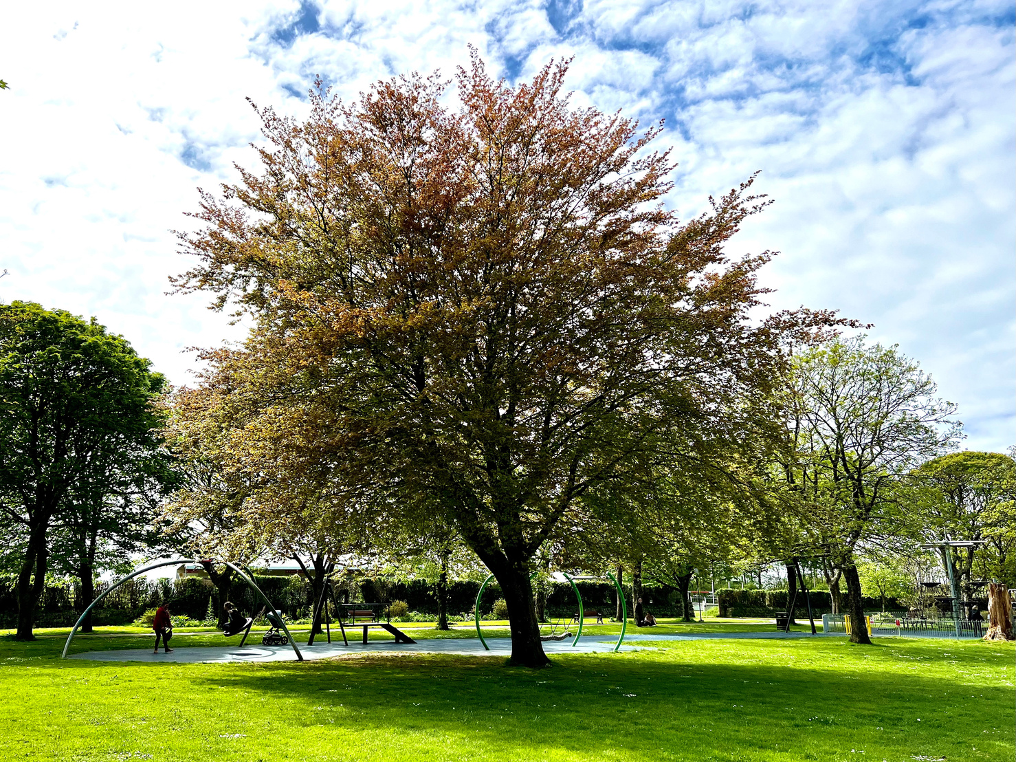
Camborne Town Council’s 2030 vision
In response to the climate threat, Camborne Town Council have declared a climate emergency and we have committed to making the Council’s activities net zero carbon by 2030. This includes activities that we permit to take place from our land and assets; or premises that are the management responsibility of the Council.
Festivals and events have an impact on the environment, this can take form in many ways such as single use plastics, waste, energy, transport, procurement of services.
Festivals and events organisers are required to understand their associated environmental impacts caused by their events and activities. We would like each event organiser to detail these and to put in place strategies to minimise, and reduce these impacts; helping the Council to reach its net zero carbon emissions by 2030.
Camborne Town Council’s Green Events Guide 2023-2024

Slide 3
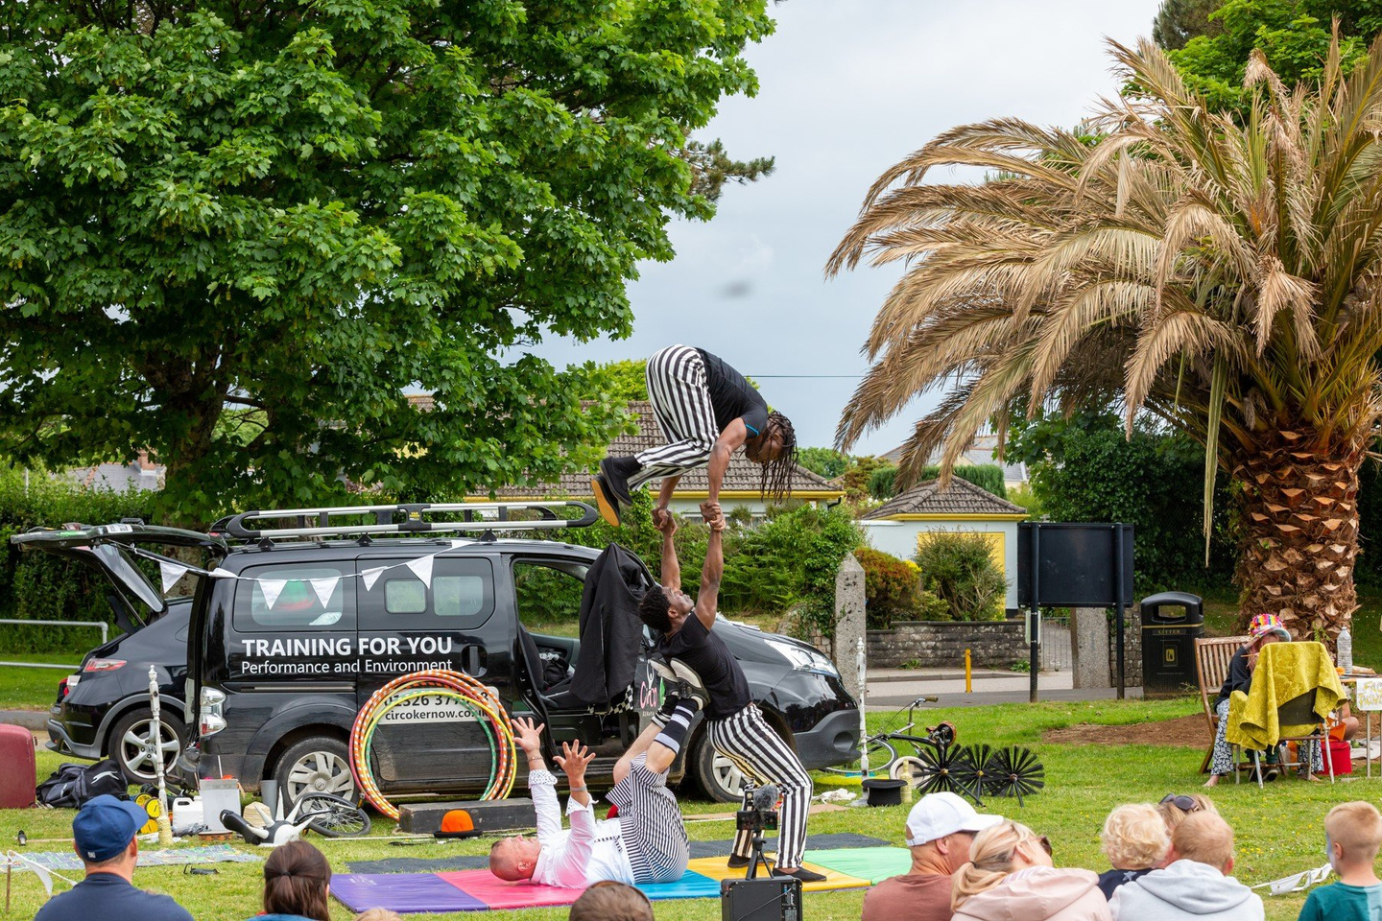
Introduction
This guide provides advice and outlines some simple steps that you should take to consider sustainability and environmental impact when organising an event.
We encourage all organisers to read this guide, review and put practical steps in place to mitigate their event carbon footprint accordingly.
As the World that we live in is rapidly changing, this guide will be update yearly.
Camborne Town Council’s Green Events Guide 2023-2024

Slide 4
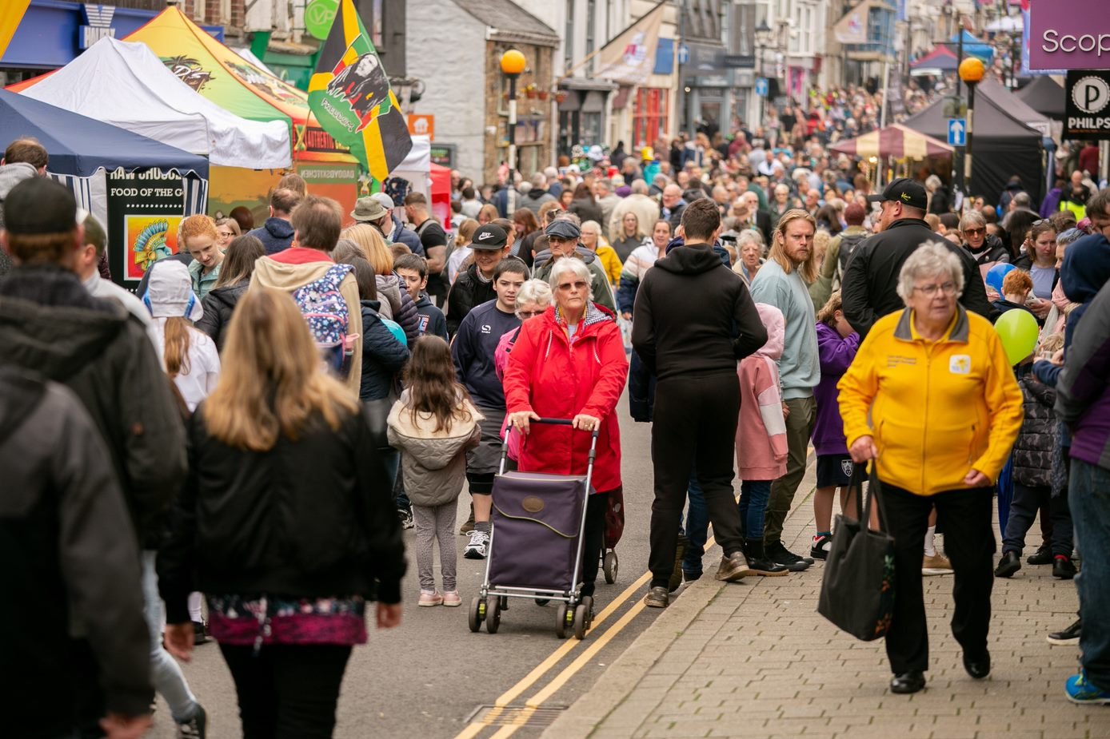
What does Camborne Town Council do?
As a Council events team, we follow this guidance for our events too. Here are some of the steps we take:
  We aim to use local suppliers where possible, and look for this during our procurement process.
  We promote recycling at our events, and offer recycling bins where possible.
  We steer away from using single use plastics, and hire in/purchase reusable options where possible.
Camborne Town Council’s Green Events Guide 2023-2024
Event Sizes
  Small Events - Up to 99 people
  Medium Events - Up to 499 people
  Large Events - 500+ people

Slide 5
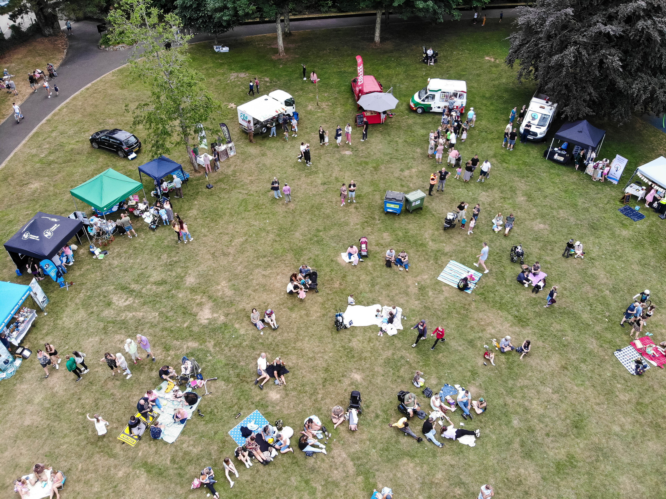
Energy
We are committed to reducing the carbon footprint of events, minimising energy use and using energy efficient equipment.
Small Events
Strongly Encouraged
  Work with partners and suppliers to minimise energy requirements.
  Switch off unused equipment.
  Use energy-efficient equipment.
Camborne Town Council’s Green Events Guide 2023-2024
Desirable
  Use of hybrid, fuel-efficient generators if required.
  Provide energy efficiency awareness raising to staff.
  Choose a venue with existing energy efficient measures.

Slide 6
Energy
We are committed to reducing the carbon footprint of events, minimising energy use and using energy efficient equipment.
Medium Events
Strongly Encouraged
  Work with partners and suppliers to minimise energy requirements.
  Use of hybrid, fuel-efficient generators if required.
  Use energy-efficient equipment.
Camborne Town Council’s Green Events Guide 2023-2024
Desirable
  Only use smokeless fuels, if required.
  Use of onsite renewable energy such as solar power.
  Choose a venue with existing energy efficient measures.

Slide 7
Energy
We are committed to reducing the carbon footprint of events, minimising energy use and using energy efficient equipment.
Large Events
Strongly Encouraged
  Work with partners and suppliers to minimise energy requirements.
  Use of hybrid, fuel-efficient generators if required.
  Use energy-efficient equipment.
Camborne Town Council’s Green Events Guide 2023-2024
Desirable
  Only use smokeless fuels, if required.
  Use of onsite renewable energy such as solar power.
  Choose a venue with existing energy efficient measures.

Slide 8
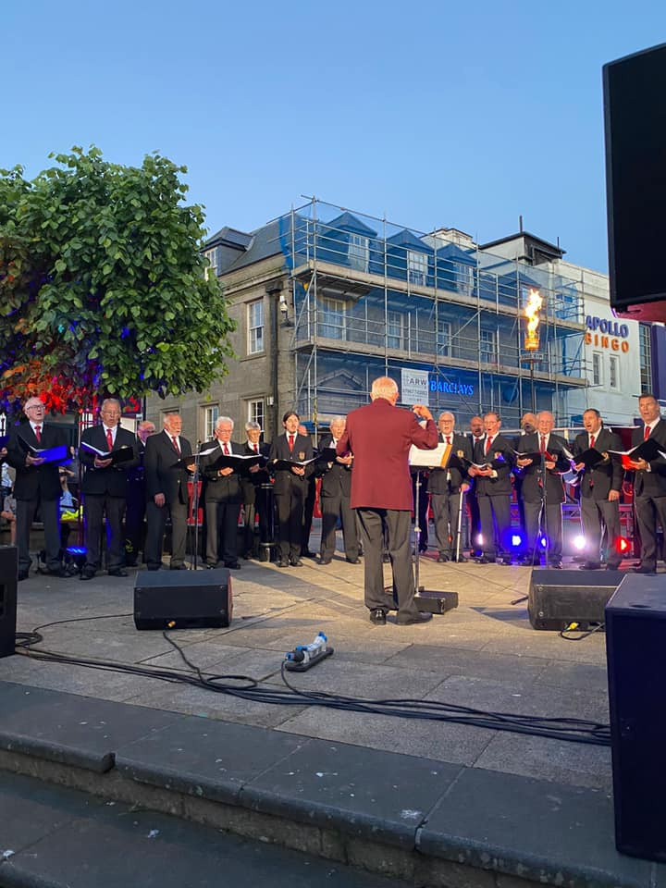
Solid Waste
Camborne Town Council committed to reducing waste throughout the Town and is active in promoting working together to reduce the social, economic and environmental impacts of litter.
Small Events
Strongly Encouraged
  Where possible do not use single plastic-coated laminates for identification and signage.
  Use of re-usable equipment/supplies over disposable.
  Provide facilities for secure storage/separation of waste types.
Camborne Town Council’s Green Events Guide 2023-2024
Desirable
  Provide on-site signage to encourage and provide information on recycling.
  Provide waste management awareness raising to staff.
  Prior to the event, identify sources who will accept wastes for re-use such as food charities.

Slide 9
Solid Waste
Camborne Town Council committed to reducing waste throughout the Town and is active in promoting working together to reduce the social, economic and environmental impacts of litter.
Medium Events
Strongly Encouraged
  Where possible do not use single plastic-coated laminates for identification and signage.
  Use of re-usable equipment/supplies over disposable.
  Provide facilities for secure storage/separation of waste types.
Camborne Town Council’s Green Events Guide 2023-2024
Desirable
  Provide on-site signage to encourage and provide information on recycling.
  Provide waste management awareness raising to staff.
  Prior to the event, identify sources who will accept wastes for re-use such as food charities.

Slide 10
Solid Waste
Camborne Town Council committed to reducing waste throughout the Town and is active in promoting working together to reduce the social, economic and environmental impacts of litter.
Large Events
Strongly Encouraged
  Where possible do not use single plastic-coated laminates for identification and signage.
  Use of re-usable equipment/supplies over disposable.
  Provide facilities for secure storage/separation of waste types.
Camborne Town Council’s Green Events Guide 2023-2024
Desirable
  Provide on-site signage to encourage and provide information on recycling.
  Provide waste management awareness raising to staff.
  Prior to the event, identify sources who will accept wastes for re-use such as food charities.

Slide 11
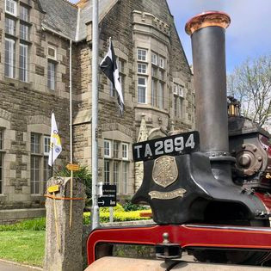
Travel and Transport
Camborne Town Council is committed to promoting sustainable transport methods. We encourage active travel (walking/cycling) and then public transport.
Small Events
Strongly Encouraged
  Promote active travel options to attendees prior to the event.
  Promote public transport options to attendees prior to the event.
  During event planning, consider proximity to transport links.
Camborne Town Council’s Green Events Guide 2023-2024
Desirable
  Provide maps and signage to direct attendees to events.
  Engage with suppliers to minimise deliveries.
  Engage with travel providers to consider enhancing transport options.

Slide 12
Travel and Transport
Camborne Town Council is committed to promoting sustainable transport methods. We encourage active travel (walking/cycling) and then public transport.
Medium Events
Strongly Encouraged
  Promote active travel options to attendees prior to the event.
  Promote public transport options to attendees prior to the event, including park and ride options.
  During event planning, consider proximity to transport links.
Camborne Town Council’s Green Events Guide 2023-2024
Desirable
  Provide maps and signage to direct attendees to events.
  Engage with suppliers to minimise deliveries.
  Engage with travel providers to consider enhancing transport options.

Slide 13
Travel and Transport
Camborne Town Council is committed to promoting sustainable transport methods. We encourage active travel (walking/cycling) and then public transport.
Large Events
Strongly Encouraged
  Promote active travel options to attendees prior to the event.
  Promote public transport options to attendees prior to the event, including park and ride options.
  During event planning, consider proximity to transport links.
Camborne Town Council’s Green Events Guide 2023-2024
Desirable
  Provide maps and signage to direct attendees to events.
  Engage with suppliers to minimise deliveries.
  Engage with travel providers to consider enhancing transport options.

Slide 14
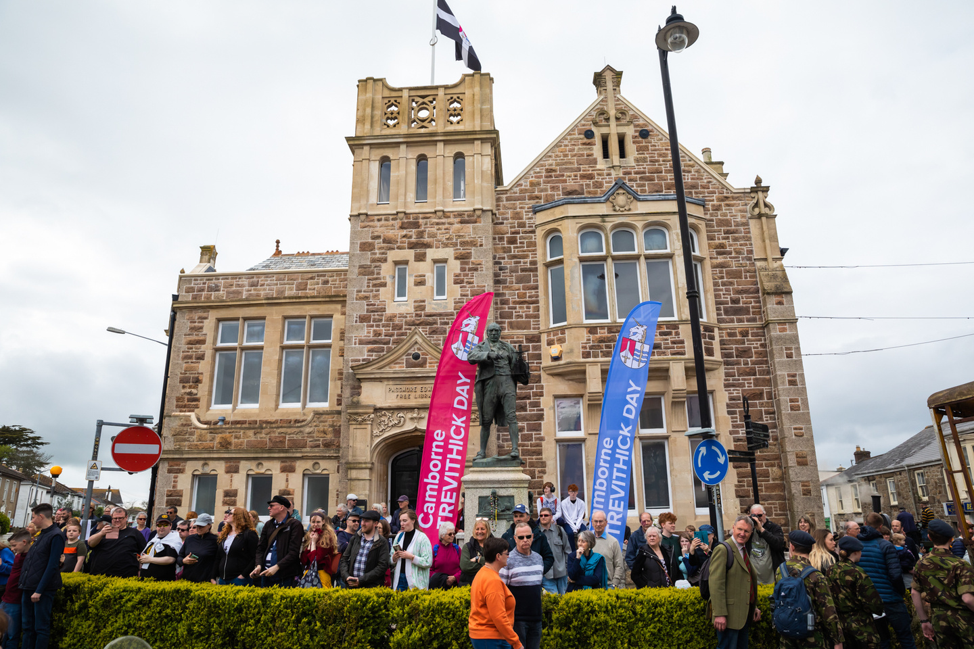
Management and Promotion
The way in which events are managed and promoted can be altered to consider sustainable options. Small changes can make big differences when utilising promotion and marketing materials.
Small Events
Strongly Encouraged
  Use e-tickets or ticketless facilities.
  Minimise print and opt for digital formats.
  Where possible, avoid dating marketing and promotional materials to allow for reuse in future years.
Camborne Town Council’s Green Events Guide 2023-2024
Desirable
  Communicate marketing and promotion methods to suppliers and traders.
  Use contractors who have an environmental certification.
  Use print materials which are recycled.

Slide 15
Management and Promotion
The way in which events are managed and promoted can be altered to consider sustainable options. Small changes can make big differences when utilising promotion and marketing materials.
Medium Events
Strongly Encouraged
  Use e-tickets or ticketless facilities.
  Minimise print and opt for digital formats.
  Where possible, avoid dating marketing and promotional materials to allow for reuse in future years.
Camborne Town Council’s Green Events Guide 2023-2024
Desirable
  Communicate marketing and promotion methods to suppliers and traders.
  Use contractors who have an environmental certification.
  Use print materials which are recycled.

Slide 16
Management and Promotion
The way in which events are managed and promoted can be altered to consider sustainable options. Small changes can make big differences when utilising promotion and marketing materials.
Large Events
Strongly Encouraged
  Use e-tickets or ticketless facilities.
  Avoid laminated promotional materials.
  Where possible, avoid dating marketing and promotional materials to allow for reuse in future years.
Camborne Town Council’s Green Events Guide 2023-2024
Desirable
  Communicate marketing and promotion methods to suppliers and traders.
  Use contractors who have an environmental certification.
  Use print materials which are recycled.

Slide 17
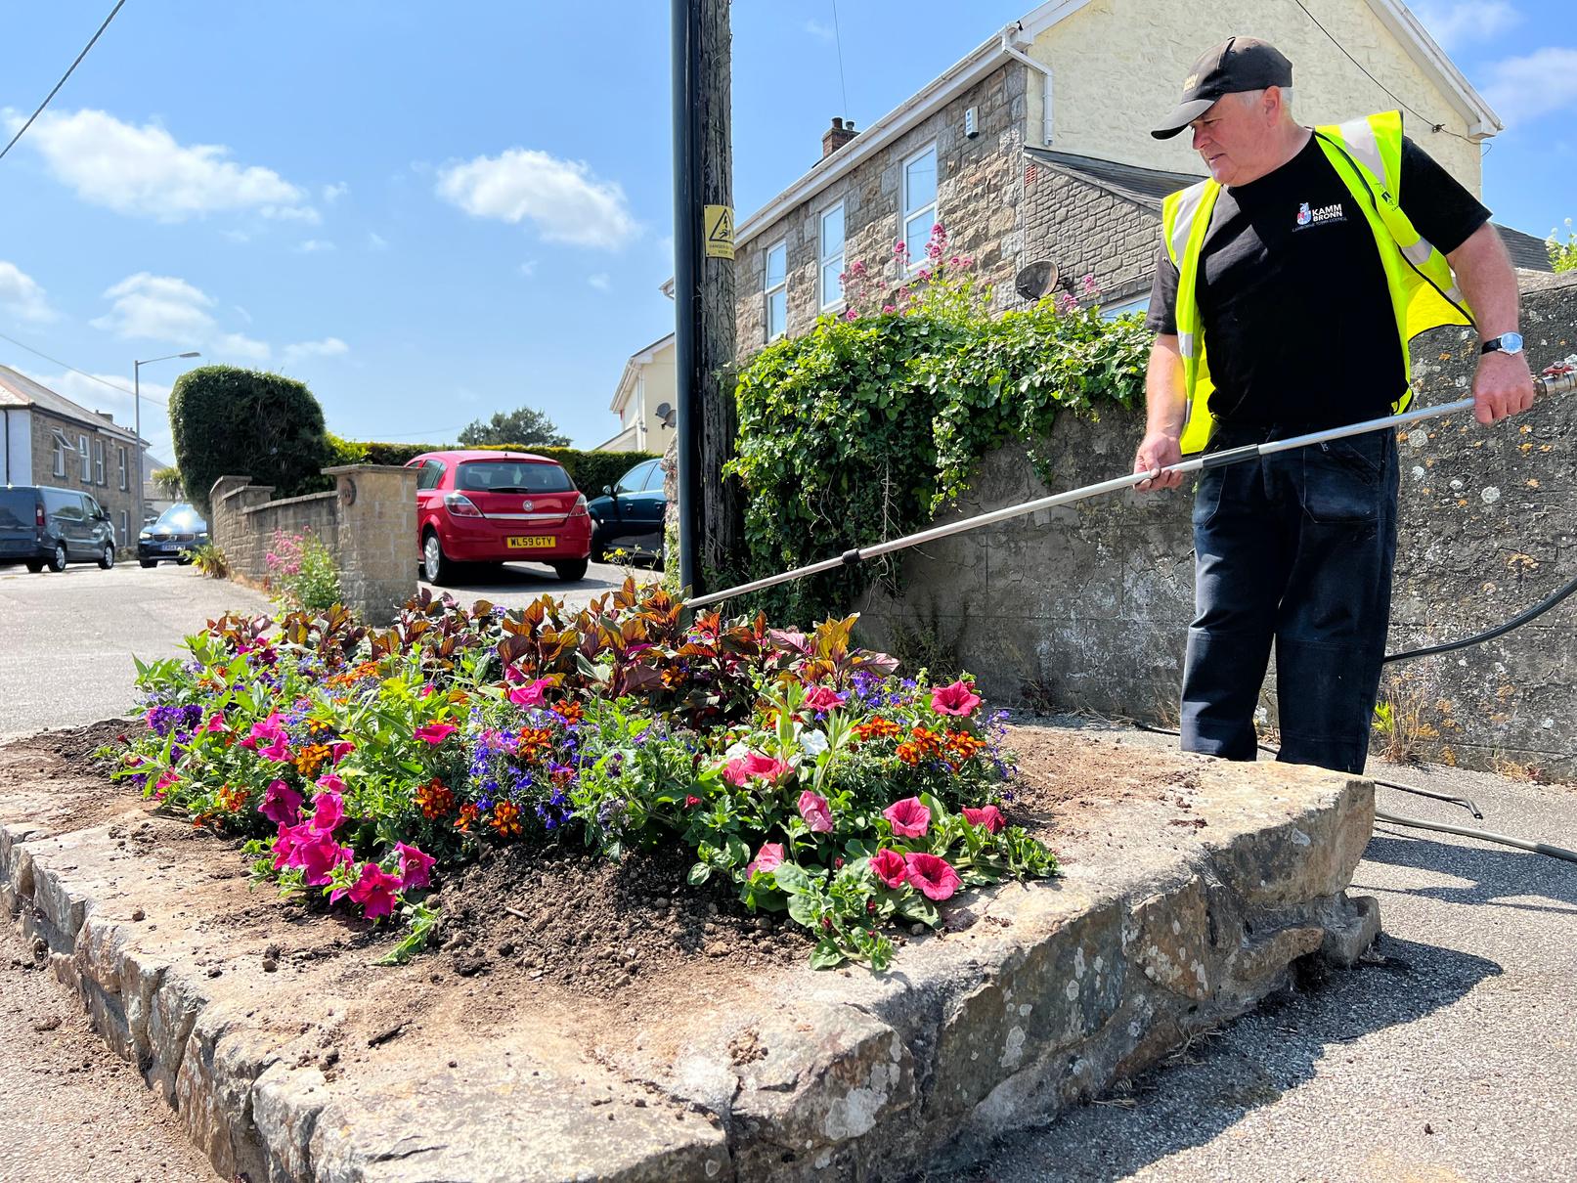
Water
Camborne Town Council aim to reduce water consumption, manage water responsibly and minimise the environmental impact of procuring water.
Small Events
Strongly Encouraged
  Provide water to event attendees in reusable cups.
  Consider water access at events in event planning.
  Provide on-site signage to water refill points.
Camborne Town Council’s Green Events Guide 2023-2024
Desirable
  Consider water waste and look at ways in which this can be minimised.
  Discourage use of plastic bottles.
  Provide event staff with reusable water bottles

Slide 18
Water
Camborne Town Council aim to reduce water consumption, manage water responsibly and minimise the environmental impact of procuring water.
Medium Events
Strongly Encouraged
  Provide water to event attendees in reusable cups.
  Consider water access and refill points in event planning.
  Provide on-site signage to water refill points.
Camborne Town Council’s Green Events Guide 2023-2024
Desirable
  Consider water waste and look at ways in which this can be minimised.
  Ban use/sale of single use plastic bottles.
  Provide event staff with reusable water bottles

Slide 19
Water
Camborne Town Council aim to reduce water consumption, manage water responsibly and minimise the environmental impact of procuring water.
Large Events
Strongly Encouraged
  Provide water to event attendees in reusable cups.
  Consider water access and refill points in event planning.
  Provide on-site signage to water refill points.
Camborne Town Council’s Green Events Guide 2023-2024
Desirable
  Consider water waste and look at ways in which this can be minimised.
  Ban use/sale of single use plastic bottles.
  Provide event staff with reusable water bottles

Slide 20
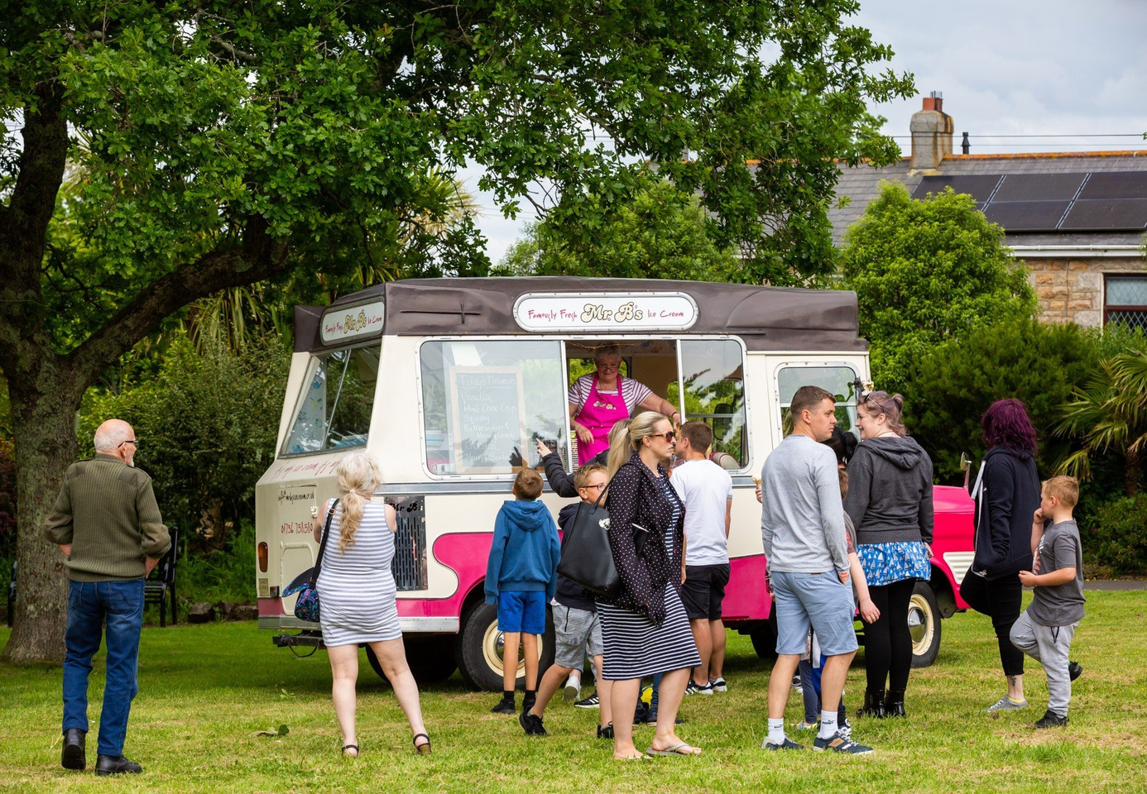
Food and Drink
Camborne Town Council strive to use food and drink which is locally sourced, sustainable and ethical.
Small Events
Strongly Encouraged
  Opt for locally sourced catering when possible.
  30% of food and drink to be vegetarian and vegan.
  Look to use Fairtrade produce in line with the town’s Fairtrade Status.
Camborne Town Council’s Green Events Guide 2023-2024
Desirable
  Ban of single use plastic cutlery.
  Dietary, source and certifications displayed on food and drink.
  Choose suppliers who have completed sustainability training.

Slide 21
Food and Drink
Camborne Town Council strive to use food and drink which is locally sourced, sustainable and ethical.
Medium Events
Strongly Encouraged
  Opt for locally sourced catering when possible.
  where possible, that meat and animal products should be avoided, with a minimum of 50% vegan and vegetarian options available. Where unavoidable, animal products used should be locally and sustainably produced with regard to the highest standards of animal welfare
  Look to use Fairtrade produce in line with our Fairtrade Town.
Camborne Town Council’s Green Events Guide 2023-2024
Desirable
  Ban of single use plastic cutlery.
  Dietary, source and certifications displayed on food and drink.
  Choose suppliers who have completed sustainability training.

Slide 22
Food and Drink
Camborne Town Council strive to use food and drink which is locally sourced, sustainable and ethical.
Large Events
Strongly Encouraged
  Opt for locally sourced catering.
  40% of food and drink to be vegetarian or vegan.
  Look to use Fairtrade produce in line with our Fairtrade Town.
Camborne Town Council’s Green Events Guide 2023-2024
Desirable
  Ban of single use plastic cutlery.
  Dietary, source and certifications displayed on food and drink.
  Choose suppliers who have completed sustainability training.

